Slide 1
PHEONI
Your personal AI assistant
Submitted by,
Arun Krishnan R
TKM23MCA-2020
Guided by,
Prof. Natheera Beevi M

Slide 2
TABLE OF CONTENT
S.NO | TITLE | PAGE.NO
1 | Introduction | 3
2 | Related Works | 4
3 | Gaps Identified | 5
4 | Problem Statement | 6
5 | Objective | 7
6 | Methodologies | 8-10
7 | Screenshots | 11-14
8 | Future Enhancement | 15
9 | Conclusion | 16
10 | Reference | 17

Slide 3
INTRODUCTION
This project focuses on building an AI-powered personal assistant application using React, Node.js and qwen coder.
Users can interact through voice or text commands to manage schedules.
It aims to enhance productivity by providing a user-friendly, interactive experience across multiple devices.
Users can access their favourite websites by adding its link.

Slide 4
RELATED WORK
S.NO | TOOL | TECHNOLOGIES | STRENGTH | WEAKNESS
1 | ALEXA | NLU Amazon Lex AWS Lambda | Wide range of Integration | Privacy Concerns
2 | SIRI | NLP Core ML Sirikit | User-friendly Interface | Limited Accessibility
3 | Google Assistant | NLP Dialogueflow Google cloud API | Comprehensive Search Capabilities | Lack of cross-platform Accessibility

Slide 5
GAPS IDENTIFIED
Limited Accessibilities
Privacy Concerns
Dependency on cloud-services

Slide 6
PROBLEM STATEMENT
Existing AI assistants provide basic interactions but fails to offer deep personalization, secure data handling, and advanced task management features. There is a need for a smarter assistant that can adapt to user preferences, understand context, and ensure privacy.

Slide 7
OBJECTIVE
1
Integrated Quantized LLM
2
Minimize cloud dependency
3
Provides Personalized responses
4

Slide 8
METHODOLOGIES
Voice Command Processing
Pheoni uses advanced speech recognition techniques to convert voice commands into actionable tasks.
Natural Language Processing
NLP is utilized to understand user inputs in text or voice form and provide contextual responses.
Identification of objects using Camera
Pheoni has a special feature to recognize an object using the camera of PC and give information about it.
Web Based Deployment
Built using React and Node.js, ensuring cross-platform compatibility and scalable architecture.

Slide 9
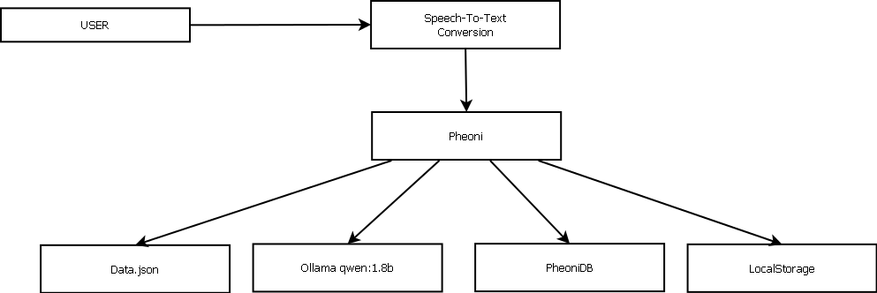
METHODOLOGIES - STRUCTURE

Slide 10
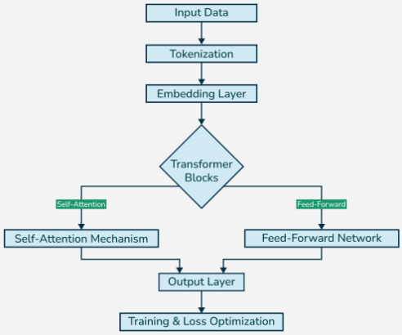
METHODOLOGIES – LLM ARCHITECTURE

Slide 11
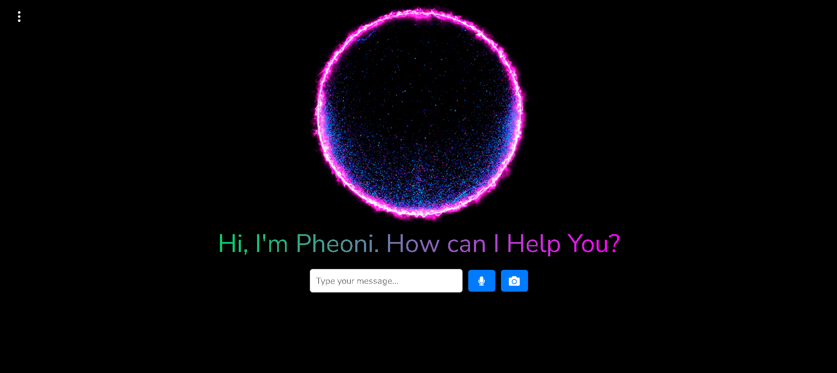
SCREENSHOT - HOMEPAGE

Slide 12
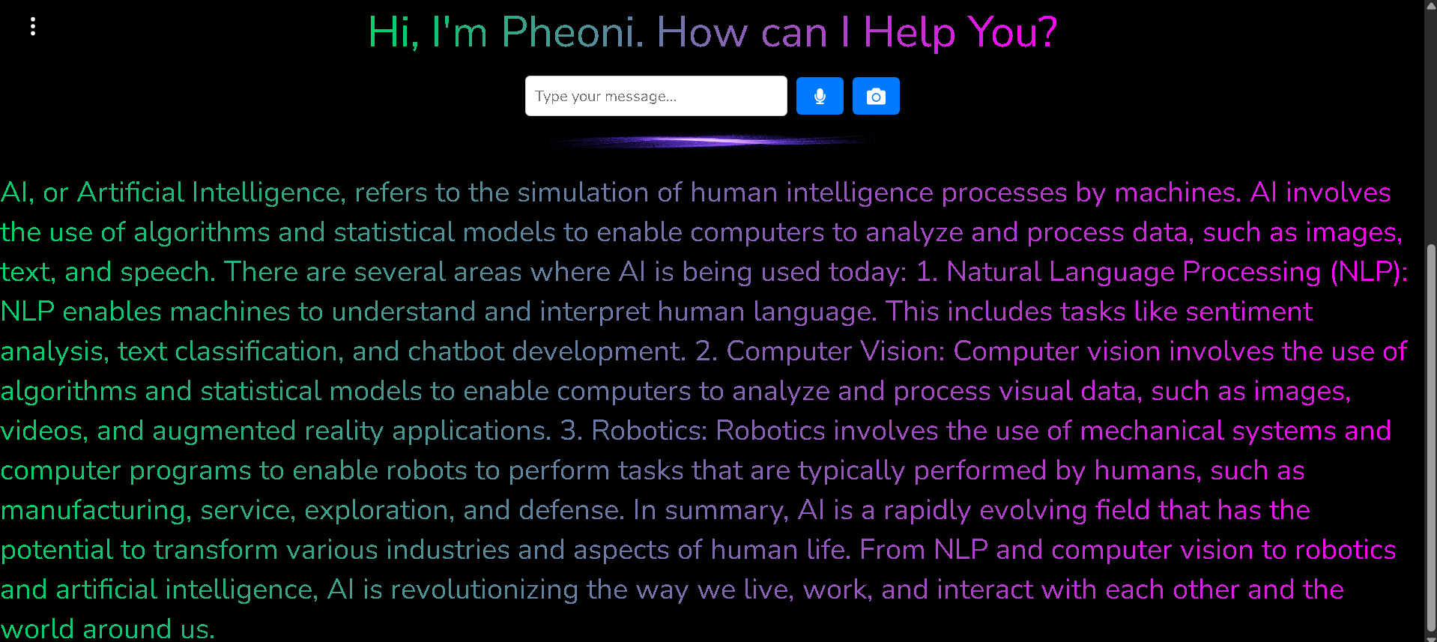
SCREENSHOT - RESPONDING

Slide 13
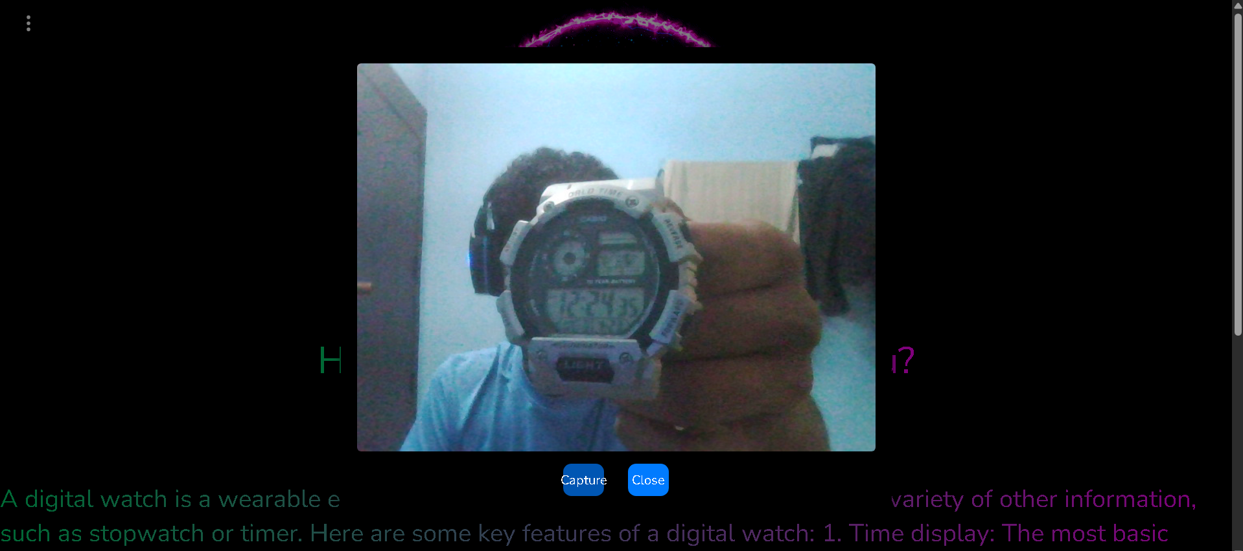
SCREENSHOT – CAMERA RESPONSE

Slide 14

SCREENSHOT - ADDING NEW LINK

Slide 15
FUTURE ENHANCEMENT
Memory and Context Awareness.
Multi turn conversations.
Sentimental Analysis.
Advanced Meeting management.

Slide 16
CONCLUSION
The Project Pheoni successfully implement NLP, set-up a quantized LLM, a structured database for storing scheduled meetings, and utilized local storage to book mark user preferenced websites and enhances the User interaction.

Slide 17
REFERENCE
1
Exploring the Determinants of User’s Continuance Usage Intention of Smart Voice Assistants
Debajyoti Pal, Mohammad Dawood Babakerkhell, Xiangmin Zhang
Year:- 2021
2
TaScaas: A Multi-Tenant Serverless Task Scheduler and Load Balancer as a Service
Vicent Gimenez-Alventosa, German Molto, J. Damian Segrelles
Year:- 2021

Slide 18
THANK YOU

